Slide 1

Hands on with Hadoop - Installation
Naren Thilla
Feb 26th 2014

Slide 2

Hadoop Installation

Slide 3
Few Options for Installation
Sandbox Installation
Best if you have admin access and 8 GB RAM. Might work on 4GB, but expect slowness.
If you have 4GB RAM on your laptop, you may want to install Oracle Virtual Box + Hortonworks (seem to work better)
Binaries available at: Z:\DATAMANAGEMENT-DEV\Share\BD
Cloud Installation
Hadoop on Google Cloud (Demonstration in class to be given by Deepak Singhal)
Hadoop Live
Both Hortonworks and Cloudera offer Demo versions that you can play with.
Bundled offering available
Hadoop with BI (Tableau/ZoomData)
Hadoop with Trifacta/Talend
http://www.cloudera.com/content/cloudera/en/products-and-services/cloudera-live.html
Hadoop on Windows (native) : http://docs.hortonworks.com/HDPDocuments/HDP2/HDP-2.2.4-Win/index.html

Slide 4



Sandbox Installation
Single Node vs. Multi Node Installation
Single, Multi and Pesudo-Distributed Mode
Installation can be done in 15 min flat!!! (Really)
Note: Do NOT violate Altisource security policies.
Host OS (Windows)
Oracle Virtual Box
Cent OS (Linux)
Hadoop

Slide 5
Sandbox Installation & Getting Started
Hadoop Distribution | Virtual Machine | Link | Comments
Cloudera – Quickstart VM + CDH 5.4 | Vmware Player | CDH: http://www.cloudera.com/content/cloudera/en/downloads/cloudera_manager/cm-5-4-3.html VM Player: https://my.vmware.com/web/vmware/downloads Z:\DATAMANAGEMENT-DEV\Share\BD | Used in the class
Cloudera – Quickstart VM + CDH 5.4.3 | Oracle Virtual Box/KVM | http://www.cloudera.com/content/cloudera/en/downloads/cloudera_manager/cm-5-4-3.html
Hortonworks – HDP 2.3 Sandbox | Oracle Virtual Box/VM Player | http://hortonworks.com/products/hortonworks-sandbox/#install
Note: Add the guest OS IP address to C:\Windows\System32\drivers\etc\hosts
Point your browser to:
http://Quickstart.cloudera:8888 (cloudera/cloudera)

Slide 6
Cloudera CDH 5.4 Sandbox
user – cloudera/cloudera
Sudo su – (for root privileges)
To start Hue
http://quickstart-cloudera:8888
What is bundled out of the box?
Apache Hadoop 2.6,
Apache Kafka 1.3
Apache Solr 4.10.3
Apache Oozie 4.1
Apache Hive 1.1
Apache Sqoop
Apache Spark v 1.3,
Hive on Spark (Beta)
Apache Zookeeper 3.4.5
Hue 3.7
Impala 2.2
Kite SDK 1.0
Release Notes: http://blog.cloudera.com/blog/2015/04/cloudera-enterprise-5-4-is-released/

Slide 7
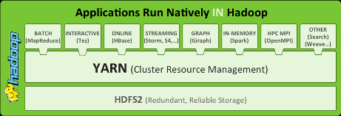
Hortonworks’ Stack

Slide 8

Hands on with Hadoop - Installation
Google Cloud Installation

Slide 9
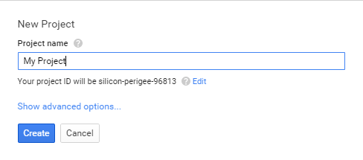
Installation:
Login into Google cloud https://console.developers.google.com
Step 1: Create Your Project: My First Project

Slide 10
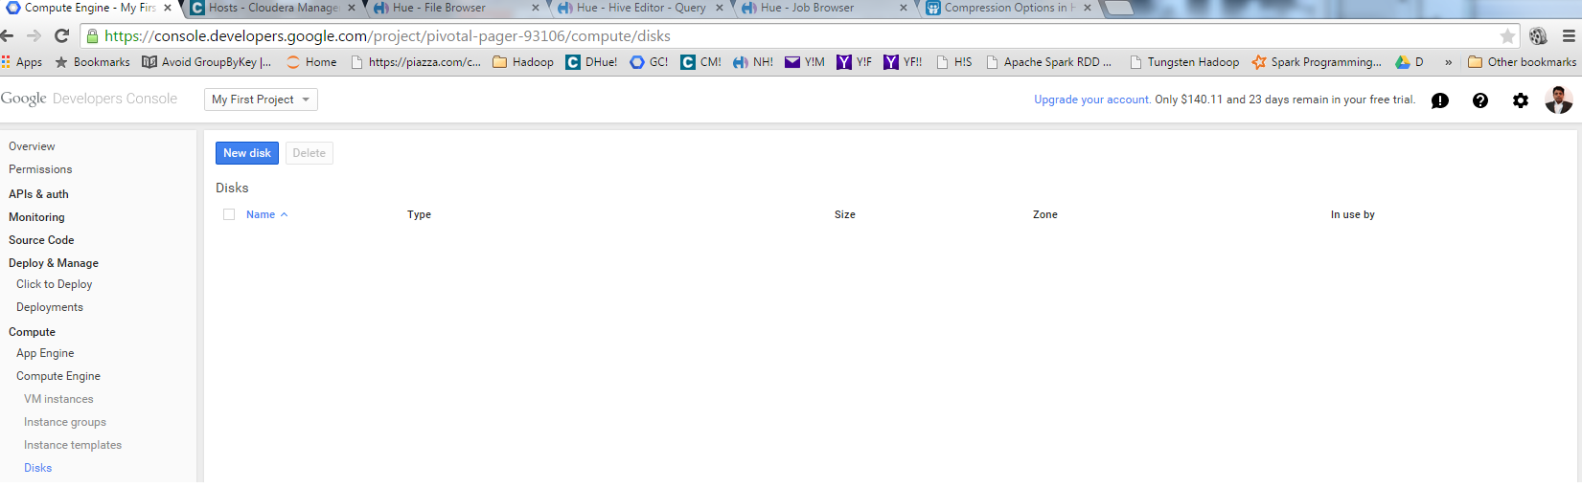
Step 2: Disk Creation
Create 4 disks of 1 TB each and call them disk-1,2,3 and 4

Slide 11
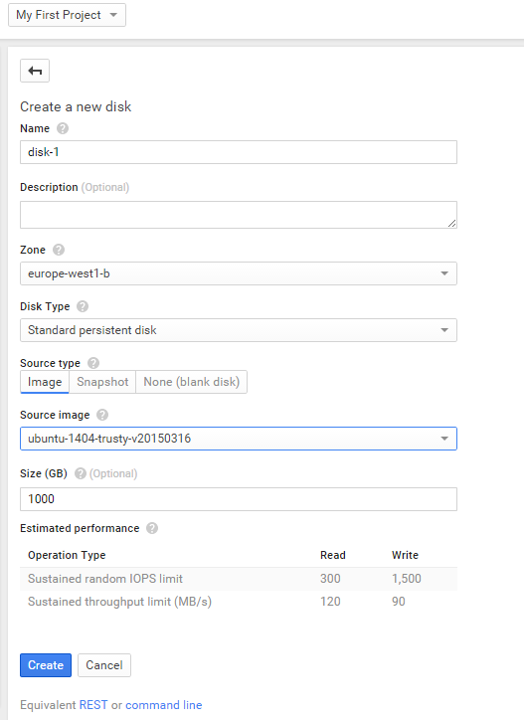

Slide 12
Step 4: Instance Creation
Create 4 Instances
VM Instances->New Instances
Choose Machine type as n1-highmem-2
Attach Disk-1 to Instance-1 and so on…
Enable HTTP and HTTPS traffic

Slide 13
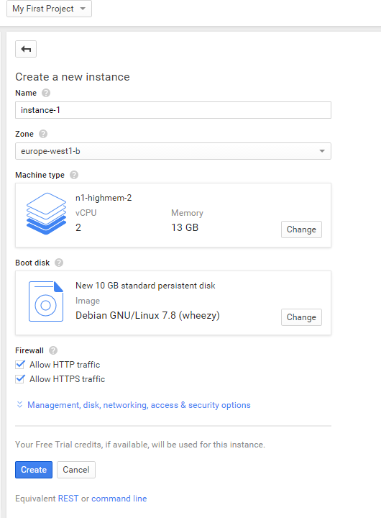
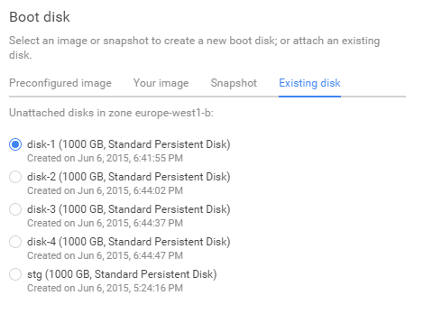

Slide 14
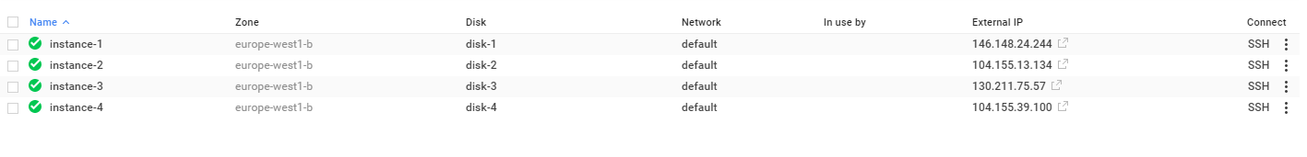
Step 4: Instance Creation (Contd..)
You should have 4 instances mapped to 4 disks :

Slide 15
Step 5: Add Firewall Rule
Click Networks->default (under Networks) ->Add Firewall Rule
Under Allowed protocols and ports: Enter tcp:1-65535

Slide 16
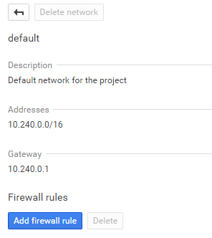
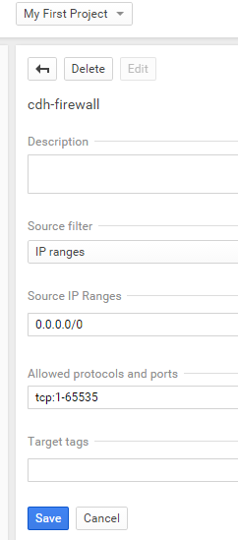

Slide 17
Step 6: Configure SSH
Use the 2 files, namely gc.pub and gc.pkey (attached here) have the public and private key you would need to SSH into Google Cloud
Open the public key and copy the contents
Create a new SSH Key and paste the contents

Slide 18
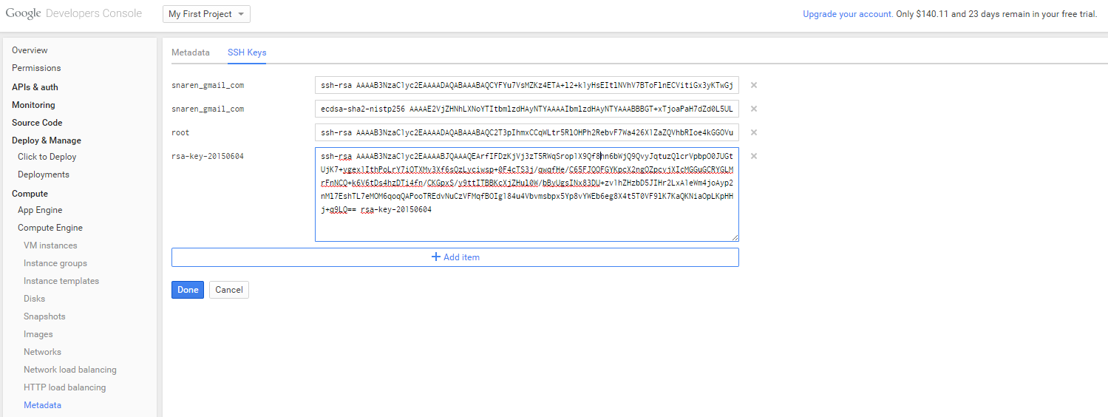
Paste the gc.pub contents here

Slide 19
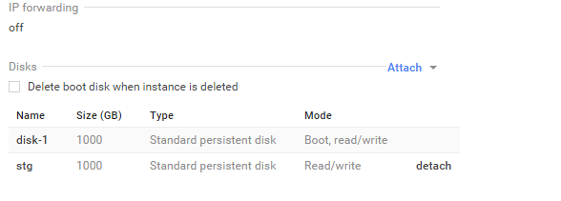
Step 6: Create Stg disk and attach to all the nodes (optional)
Create a new disk called Stg of 1 TB size and attach it to instance-1.
This disk will be used to load staging files such as wikipedia data and other source files.
Click on instanc-1 and attach stg disk.

Slide 20
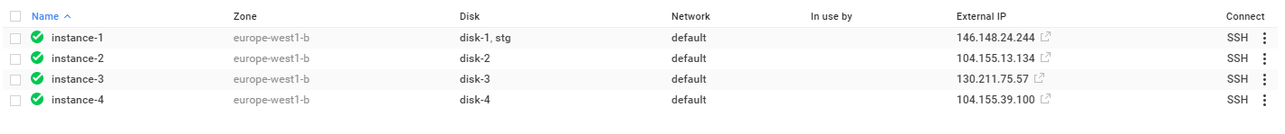
SSH into the instance
Click on SSH (instance-1) and run ls and other unix scripts.
This completes the basic Google Cloud Installation.
This is where CDH will be installed later
This completes your Google Cloud 4 node cluster installation.
Note down the “external ip” of instance-1. We will use this to configure CDH.
Proceed to next page for Cloudera CDH installation.

Slide 21
Install Cloudera CDH on the cloud
SSH into one of the nodes (say instance-1) and run download CDH installer.
Run the following commands:
$ Sudo su -
$ Mkdir /opt/downloads
$ Cd /opt/downloads
$ wget http://archive.cloudera.com/cm5/installer/latest/cloudera-manager-installer.bin
$ chmod u+x cloudera-manager-installer.bin
$ sudo ./cloudera-manager-installer.bin
Follow the rest of the steps (usually defaults) mentioned at: Follow Quick Start Guide at http://www.cloudera.com/content/cloudera/en/downloads/cloudera_manager/cm-5-4-0.html

Slide 22
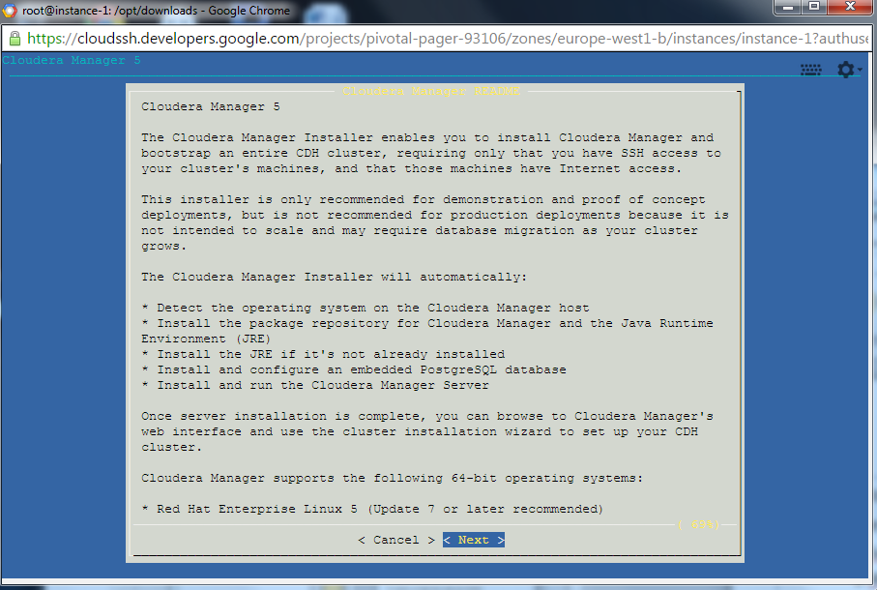

Slide 23
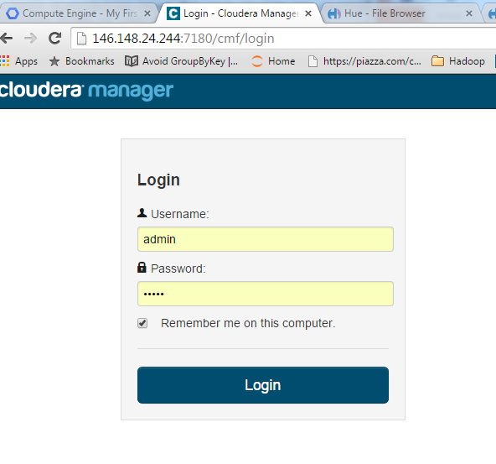
Configure CDH
Point your web browser to:
http:// <external ip address of instance-1>:7180> and complete the rest of the steps
Login using admin/admin
Admin/admin is the username/password
Note: It takes ~5 min for the setup (in the previous steps to take effect). Port 7180 may be unresponsive for such time.

Slide 24
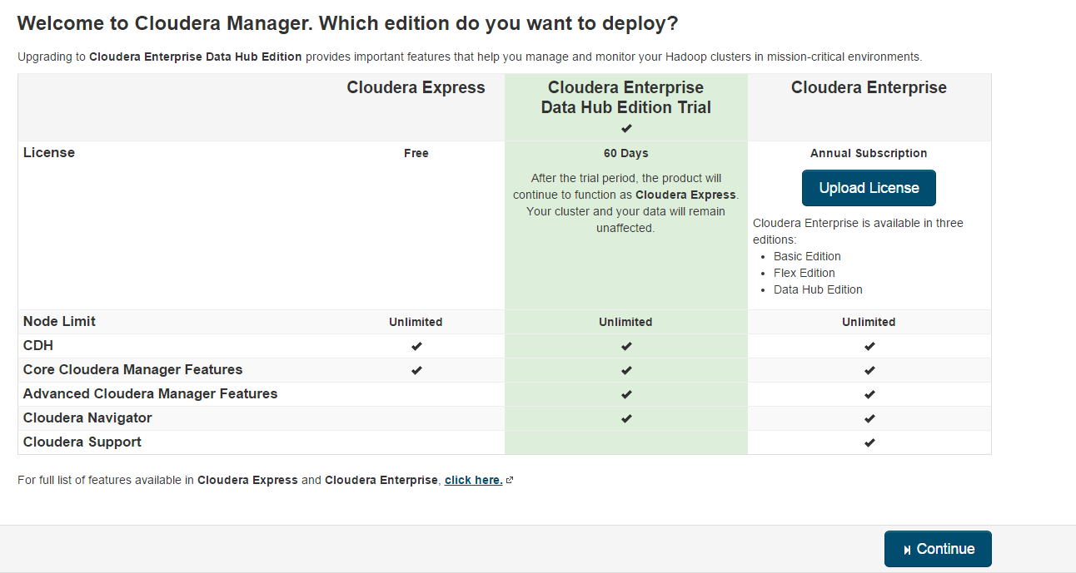
Configure CDH
Install Cloudera Enterprise (It will automatically roll back to free edition after the license expires)
The following components will be installed:
Apache Hadoop (Common, HDFS, MapReduce, YARN)
Apache HBase
Apache ZooKeeper
Apache Oozie
Apache Hive
Hue (Apache licensed)
Apache Flume
Cloudera Impala (Apache licensed)
Apache Sentry
Apache Sqoop
Cloudera Search (Apache licensed)
Apache Spark

Slide 25
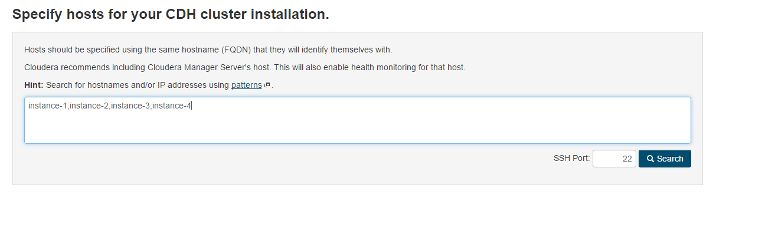
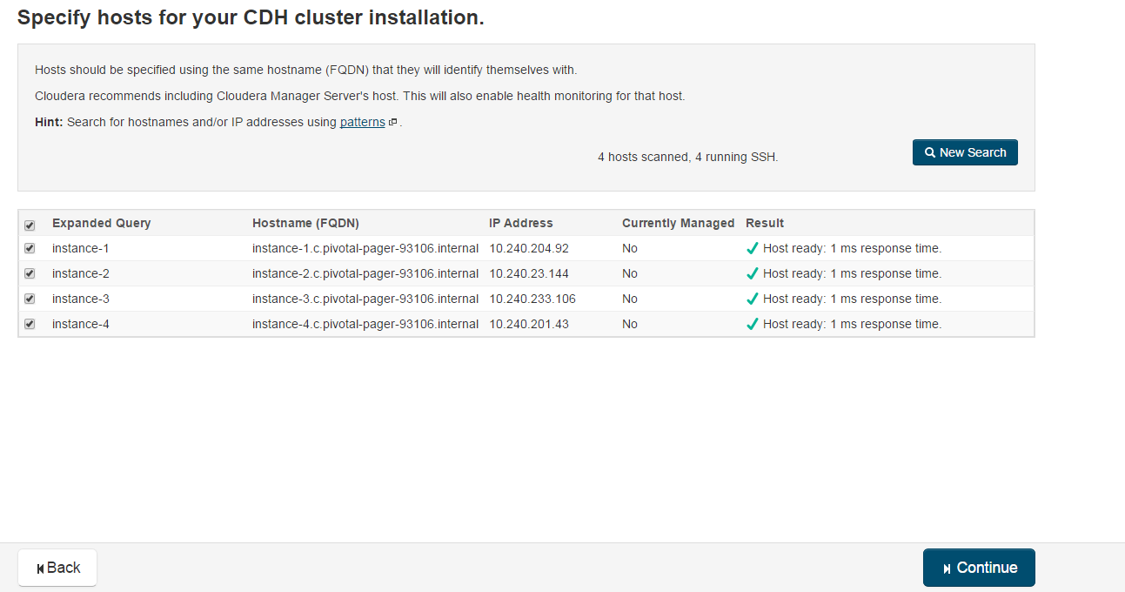
Specify Hosts

Slide 26
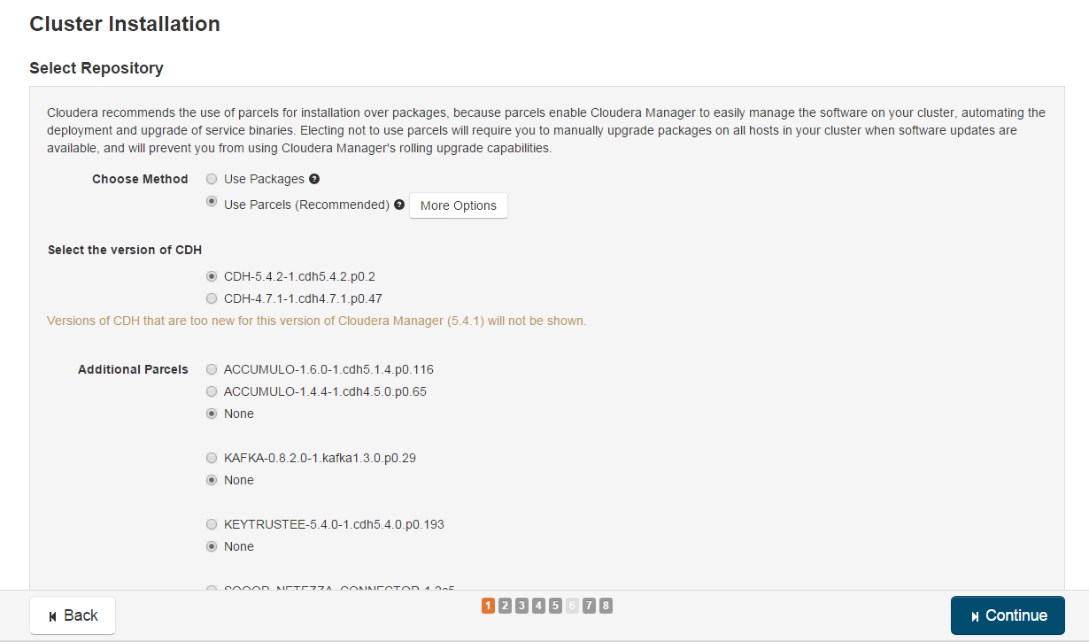

Slide 27
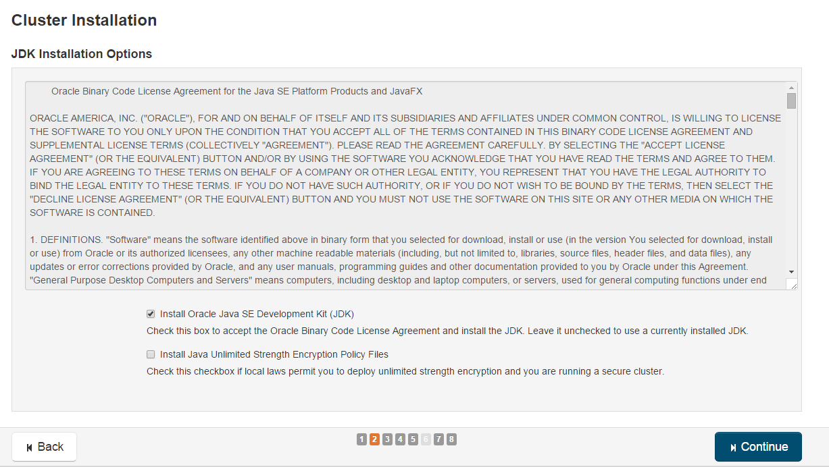

Slide 28
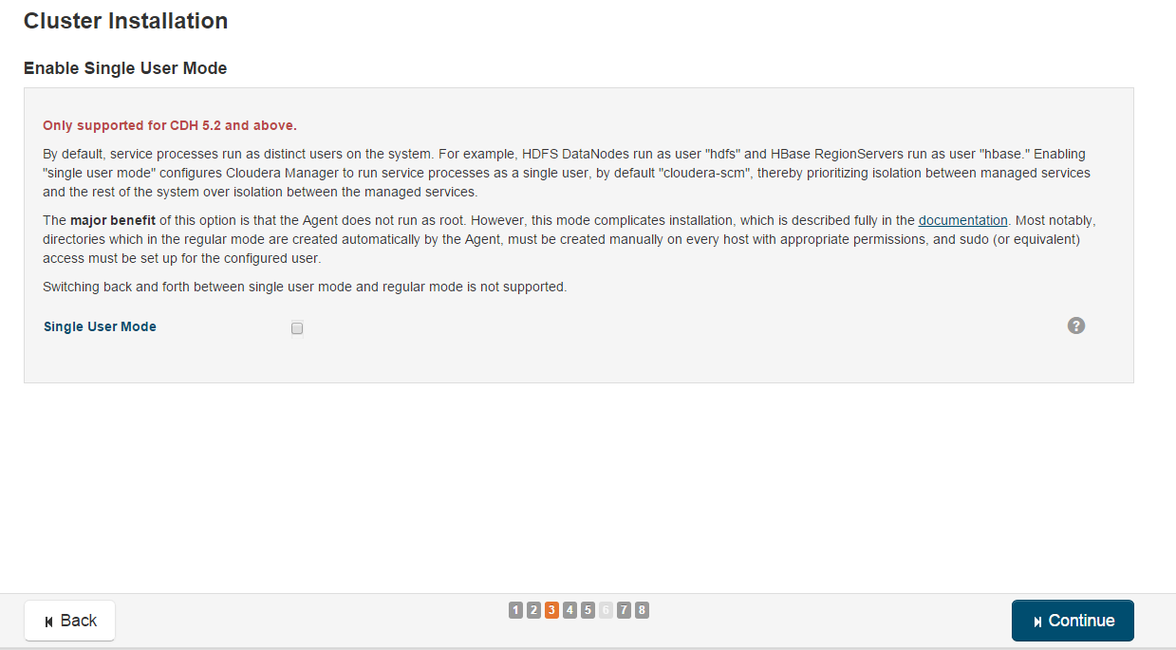

Slide 29
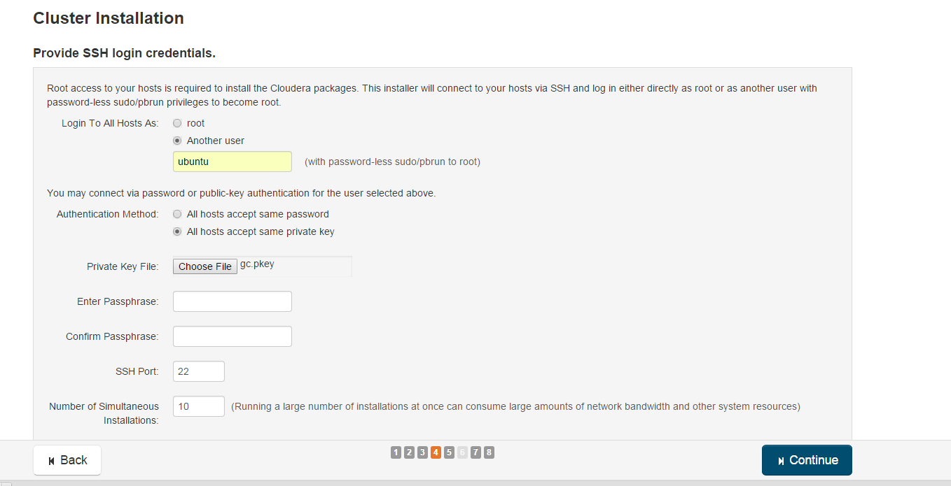
Cluster Configuration - SSH
Login into All Hosts As: ubuntu
Authentication Method: All hosts accept same private key (choose file gc.key stored from earlier page).

Slide 30
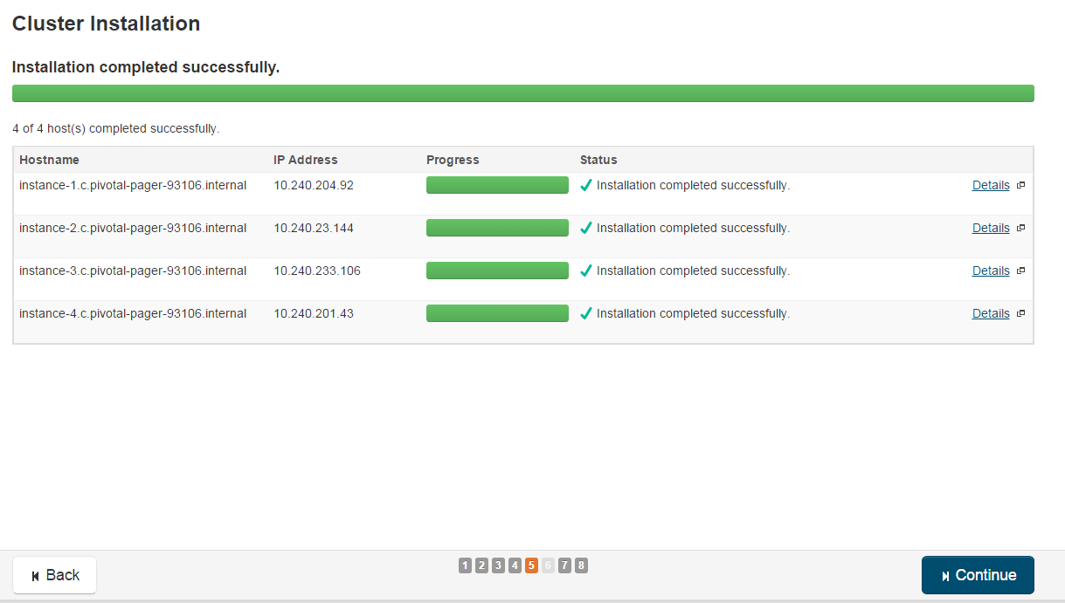
Note: Make sure that the cluster installation completes successfully on all 4 nodes.
If you get heart-beat error, then ensure that you have entered the name of the node (instance-1 and not the IP address)
You can add/delete nodes later.

Slide 31
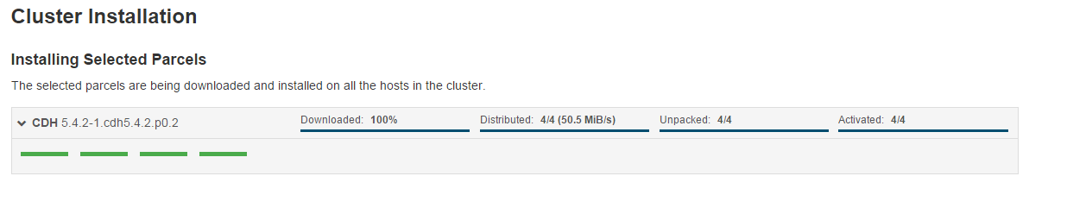
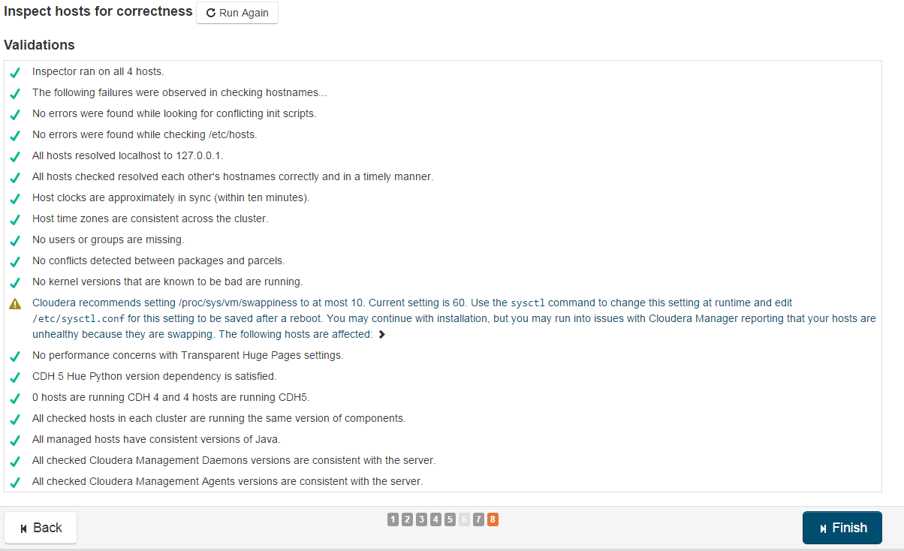

Slide 32
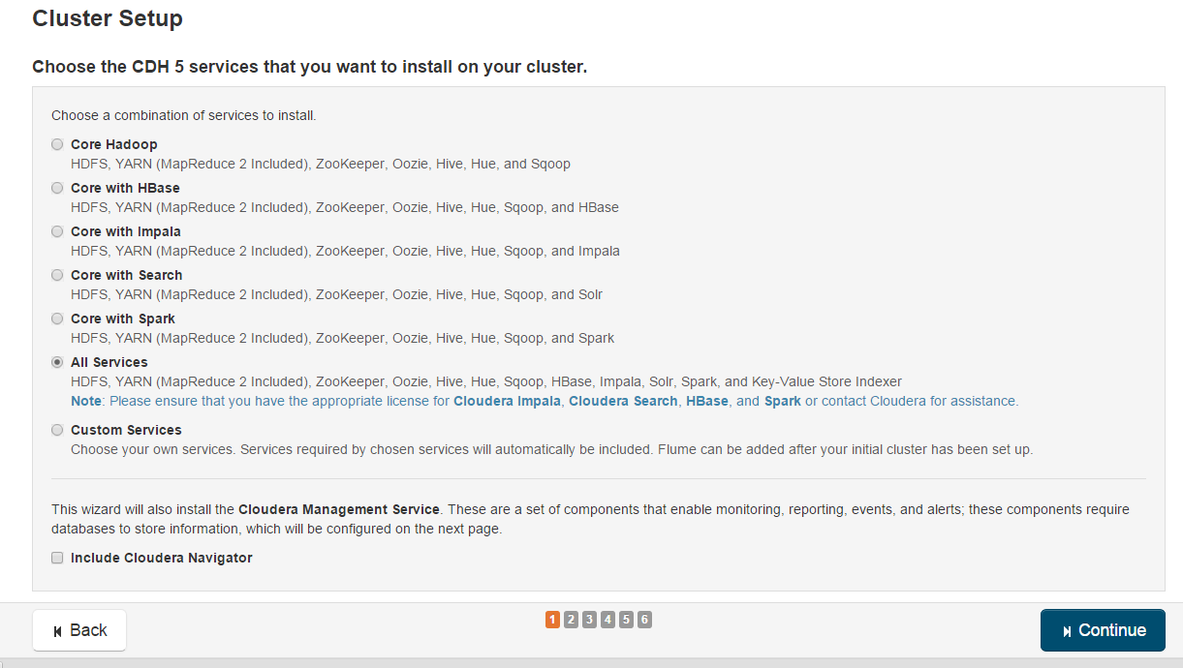
Cluster Setup
Choose “All Services”
This includes Core Services (YARN (Map –Reduce 2), HDFS) ZooKeeper, Oozie, Hive, Hue, Sqoop, HBase, Impala, Solr, Spark, and Key-Value Store Indexer

Slide 33
Role Assignment
Assign Instance-1 as the Name node and the 3 other nodes as data Nodes
Spread the load (roles) of other servers (such as Spark, Hue, Oozie, Hbase etc across the cluster).
Otherwise, instance-1 will end up having higher memory utilization which will result in run-time errors.

Slide 34
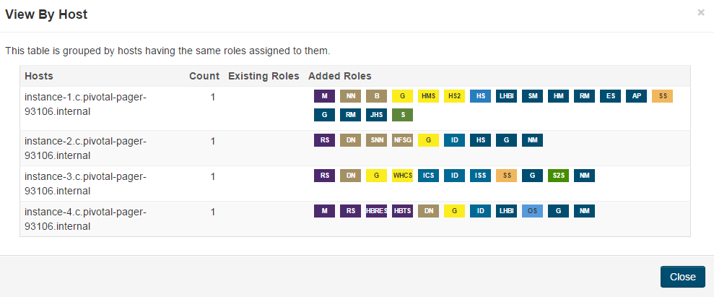

Slide 35
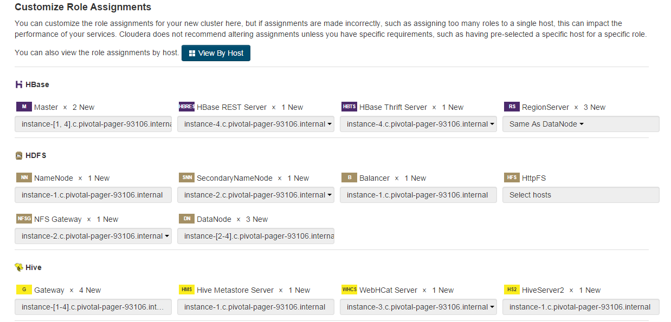

Slide 36
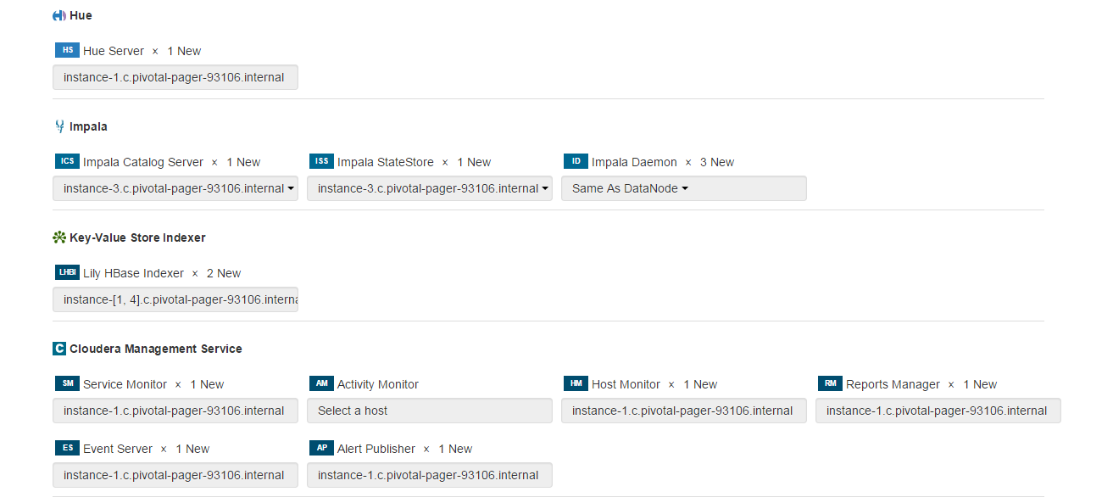

Slide 37
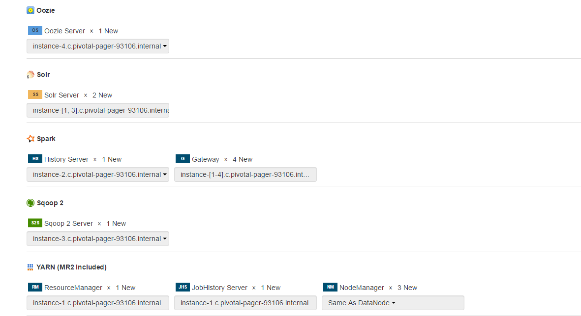

Slide 38
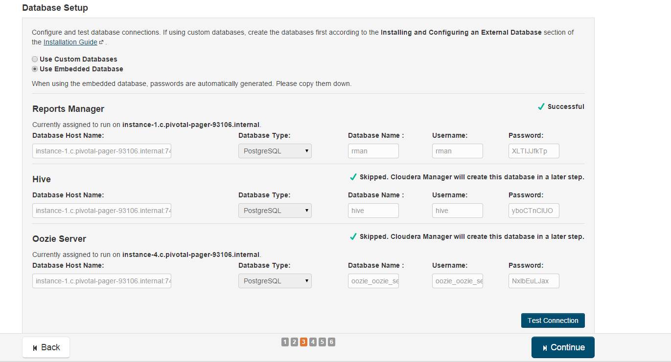

Slide 39
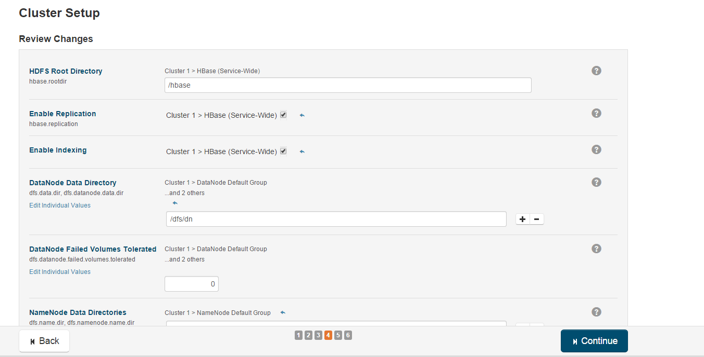
Note: Accept the defaults

Slide 40
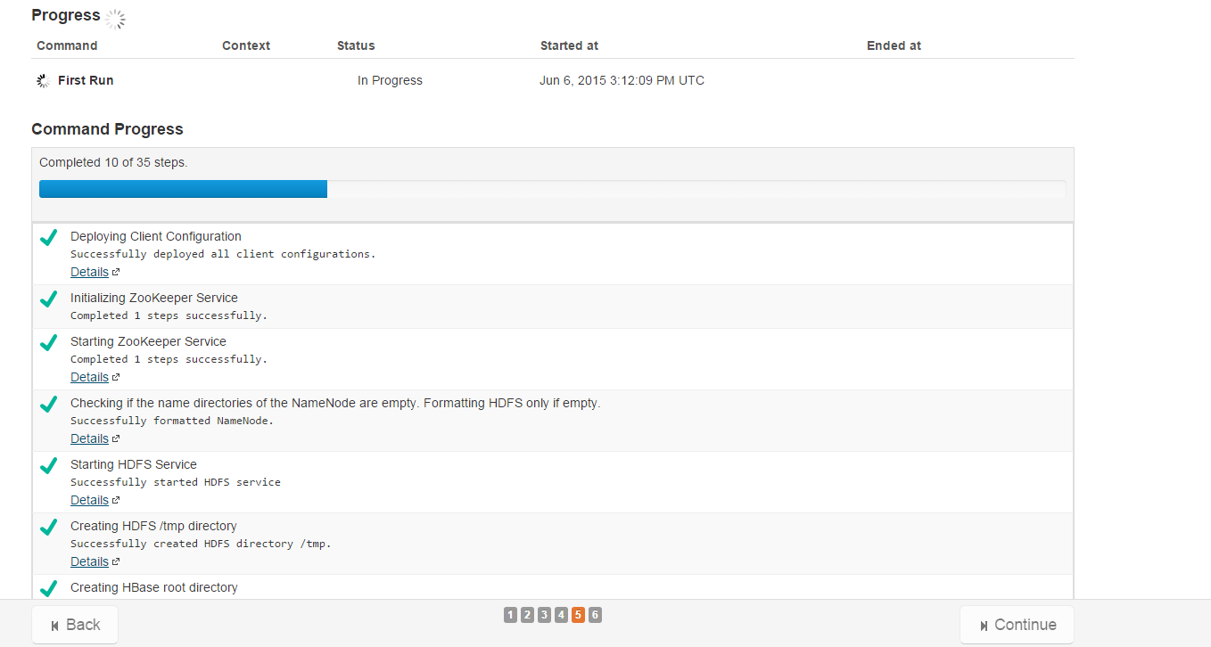

Deployment of Client Config
Note: Based on the selection, close to 35 steps would be implemented.

Slide 41
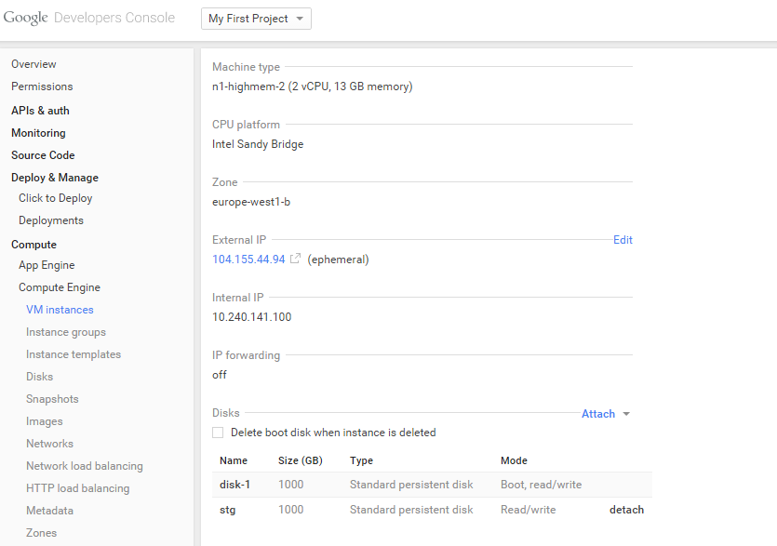
Mounting Stg disk onto Instance-1 (Optional)
Attach disk stg to Instance-1
Note: SSH into instance-1
Sudo su -
Mkdir /mnt/stg
Mount –t ext4 /dev/disk/by-id/google-stg /mnt/stg

Slide 42
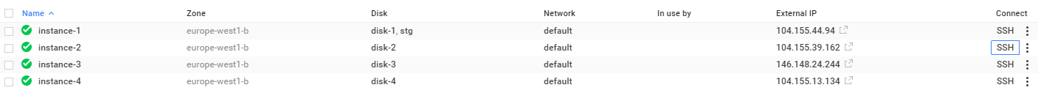
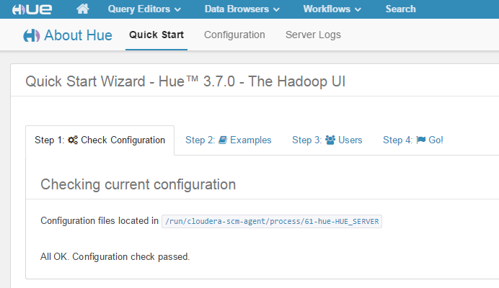
Test your Setup
Locate the external IP address of Instance-1 and start hue by pointing your browser to port 8888
Enter cloudera/cloudera as hue username/password
Congrats !! You have successfully deployed CDH on Google Cloud

Slide 43
HDFSMount (optional)
Doing a HDFS Mount will allow you to copy files from windows or unix directory into HDFS as if it is a local copy.
This will also allow files (data ingestion) to be ingested directly from another host
For example, the ARLT .tpe files can be HDFSMounted. This will allow for direct loading of .TPE extactions into Hadoop
$ sudo apt-get install fuse
$ mkdir –p /mnt/hdfs
$ hadoop-fuse-dfs dfs://instance-1:8020 /mnt/hdfs
$ adduser cloudera <enter cloudera as the password>
Test file transfer
$ su cloudera
$ vi /home/cloudera/x <Enter some text and save it>
$ cp x /mnt/hdfs/user/cloudera
$ Verify if the file X exists in Hue

Slide 44
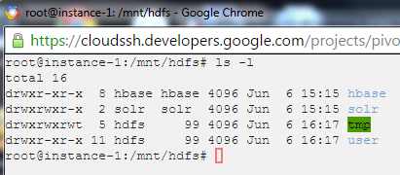
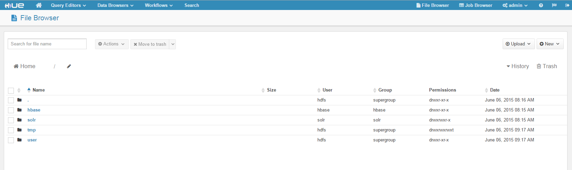
Verify the HDFS Mount via Hue

Slide 45
File Transfer (WinSCP)
Step 1: Download WinSCP to transfer file from: http://winscp.net/eng/download.php
Step 2: Generate Putty public and private keys
WinSCP requires that you use putty-gen to create the public and private key.
The putty s/w is also bundled with the winSCP binaries.
Run puttygen and click Generate (move your mouse to generate some randomness)
Step 3: Configure WinSCP
Step 3a: Run the Winscp client and then enter the proxy details (when connecting from the office)
Step 3b: Authenticate using the putty private key
Step 3c: Copy the contents of putty.pub file and enter into Google Cloud Browser window under Metadata-> SSH Keys->Edit (+).
This step is similar to the step in page 11.
Step 4: Credential Setup.
Enter the “external” IP address of instancce-1 (from the console)
Leave the default port as 22
The user name – rsa-key-xxxx will also be populate automatically
No password is required.

Slide 46
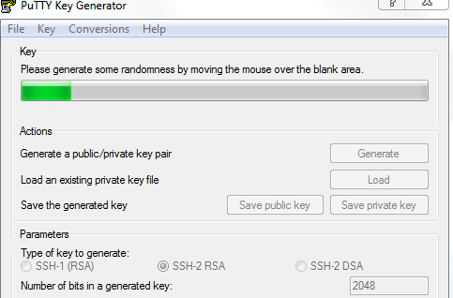
Step 2: Putty Key Generation

Slide 47
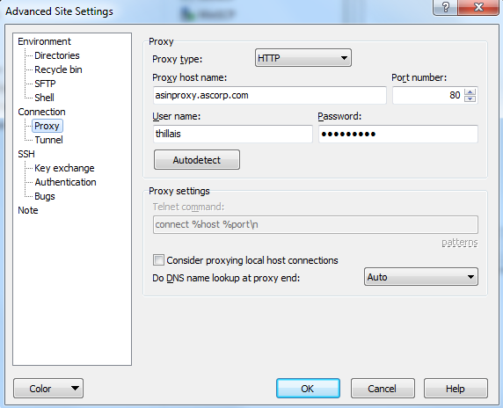
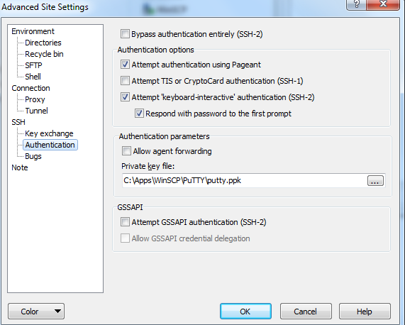
Step 3b: Private Key Authentication
Step 3a: Proxy Setting

Slide 48
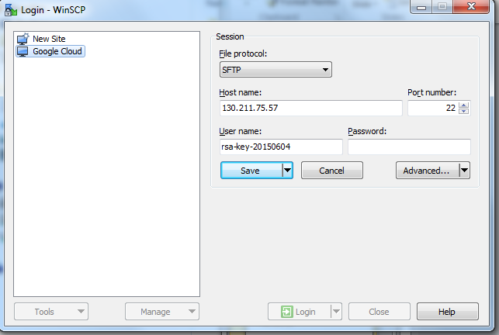
Step 4: Credential Setup

Slide 49
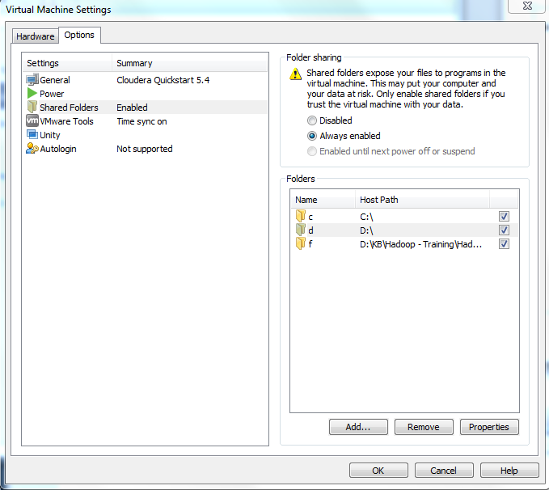
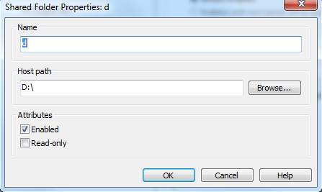
Mounting Windows File onto Cloudera Sandbox
Step 1: Open the Sandbox click on:
Player->Manage->Virtual Machine Setting (Ctrl-D)->Options->Shared Folders
Define the mount point as below:
Step 2: Log into the Sandbox:
$ Sudo su –
cd /mnt/hgfs/d
mount -t vmhgfs .host:/d /mnt/hgfs/d (This will mount windows D:\ onto /mnt/hgfs/d

Slide 50
Hands on with Hadoop
Hello World Examples
Naren Thilla
Apr 28th 2015

Slide 51
HDFS – Command Line Interface
Hadoop fs <args>
Hadoop fs –ls
Hadoop fs -copyFromLocal file://wc.txt hdfs://localhost/user/hue/wc.txt
hadoop fsck / -files -blocks
https://hadoop.apache.org/docs/r0.18.3/hdfs_shell.html

Slide 52
Sample Java Program
http://hortonworks.com/hadoop-tutorial/introducing-apache-hadoop-developers/
https://sites.google.com/site/hadoopandhive/home/how-to-read-all-files-in-a-directory-in-hdfs-using-hadoop-filesystem-api
HDFS Java Program
Map-Reduce Java Program
Using Eclipse
https://sites.google.com/site/tacchadoop/home/word-count-example-part-i---create-your-own-jar
Add JAR files from: <z:\....\external jars>
Compile and export as a JAR file,
Sample HDFS HelloWorld Programs: <z:\.....code\hdfs\ HDFSExamples.jar>
Running the program
Copy the JAR file via mount/hgfs (or)
FTP the jar file in binary mode.
Run the program as follows:
hadoop jar <HDFSExamples.jar> hdfs://localhost:8020/user/cloudera/1.sql (or any file available in HDFS>
Sample MR WordCount Program: <D:\workspaces\Hadoop\MR\WordCount.jar>
Running the program
Hadoop jar WordCount.jar hdfs:// localhost:8020/user/cloudera/1.sql (or any file available in HDFS) hdfs://localhost:8020/user/cloudera/wc.out
Note: If you are connecting from windows host, use quickstart.cloudera instead of localhost

Slide 53
Monitoring the Jobs
Monitoring the Job
Point Browser to http://localhost:8888/jobbrowser to monitor jobs

Slide 54
Measuring the WordCount Performance
Generate a large file:
http://www.skorks.com/2010/03/how-to-quickly-generate-a-large-file-on-the-command-line-with-linux/
Z:\datamanagement-dev\HDP Sessions
Generate a seed file called file.txt with sample 1 or 2 line text and use genData to generate a large file
1.3 GB file (251M words, 50M lines)
Java WordCount Performance:
http://www.roseindia.net/java/beginners/WordCount.java
Z:\datamanagement-dev\HDP Sessions
Run JavaWordCount Program
Java –jar JavaWordCount.jar <file.txt>
30 seconds

Slide 55
Measuring the WordCount Performance (Contd..)
Run HadoopWordCount Map Reduce Program
Load file.txt into HDFS, say under /user/cloudera/file.txt
Pick up the jar file at Z:\Data-Mamagement Dev\HDP Sessions\code\WordCount.jar
Copy the Jar and run
Hadoop jar WordCount.jar hdfs://localhost:8020/user/cloudera/file.txt hdfs://localhost:8020/cloudera/file.out
Run HadoopWordCount Spark Program
$ Spark-shell
Run contents of D:\workspaces\Hadoop\spark
wordCount (uncached Spark)
wordCountCache1 (Cached – Ist instance)
wordCountCache2 (Cached – 2nd instance)

Slide 56
Measuring the WordCount Performance (Contd..)
Hardware Configuration | Data Size | POJO | MapReduce | Spark | Comments
Cloudera Sandbox (4GB) on a Windows 8 GB machine | 1.3 GB File | 30 sec | 50% - 30 min (Aborted) | 52 sec (Spark on Native FS) Spark on HDFS 46 sec (Uncached) 121 sec (Ist Cache) 95 sec (Iind cached) <Likely pagination happening>
20 Node Cluster (Setup by Berkeley) | 50 GB (Wikipedia – English) |  |  | 48 sec 2 sec (cached) | https://www.youtube.com/watch?v=e-56inQL5hQ

Slide 57
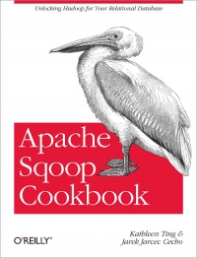

Sample Sqoop Transfers & Hive
Sqoop can be used to import data from any RDBMS into HDFS, Hive or Hbase
Refer: https://github.com/jarcec/Apache-Sqoop-Cookbook
<Run the two .SQL files to load data into Mysql)
$>sqoop import --connect <JDBC connection string> --table <tablename> --username <username> --password <password>
$> sqoop import --connect jdbc:mysql://PTP-LT-2XNMSQ12/sqoop --username sqoop2--password sqoop --table cities
$> sqoop import --connect jdbc:mysql://PTP-LT-2XNMSQ12/sqoop --username sqoop2--password sqoop --table cities --hive-import
http://hortonworks.com/kb/using-apache-sqoop-for-data-import-from-relational-dbs/
http://archive.cloudera.com/cdh/3/sqoop/SqoopUserGuide.html

Slide 58
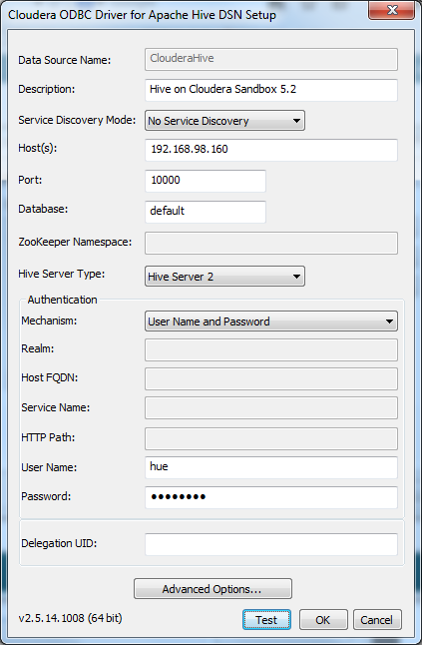
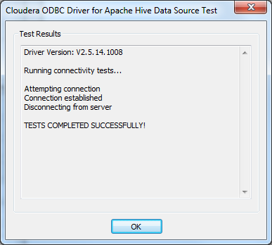
Connecting BI Tool with Hadoop
Download the 64 bit ODBC driver:
http://www.cloudera.com/content/cloudera/en/downloads/connectors/hive/odbc/hive-odbc-v2-5-14.html
http://social.technet.microsoft.com/wiki/contents/articles/6226.how-to-connect-excel-to-hadoop-on-azure-via-hiveodbc.aspx
Install ODBC 64 bit driver
Control Panel->System and Security->Administrative Tools->Setup Data Sources (ODBC)
User: hue/cloudera
Use the IP address of the sandbox
Click on Test to independently test the DSN

Slide 59
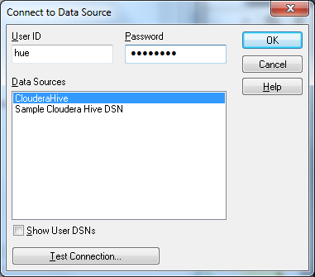
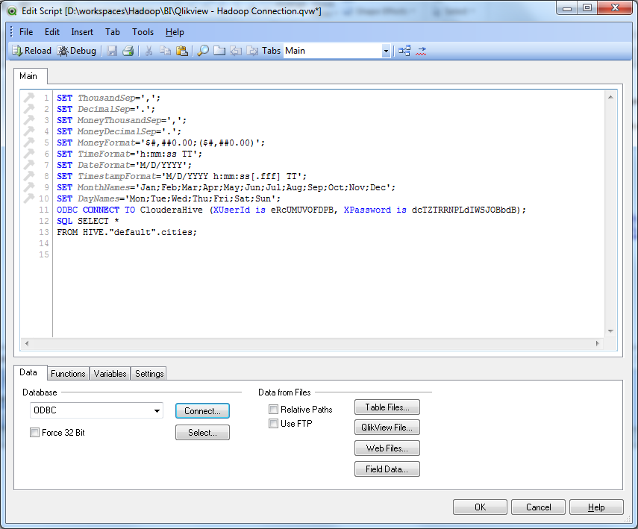
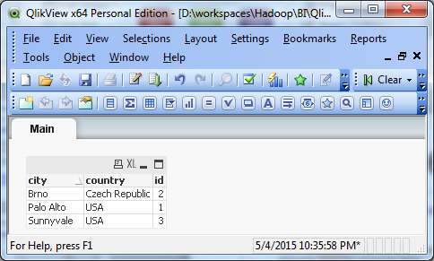
Connecting BI Tool via ODBC
Install Qlikview 64 Bit Edition
http://www.qlik.com/us/explore/products/free-download
Create a New Report
File->Edit Script (Ctrl-E)
Choose ODBC and then Click Connect.
Enter hue/cloudera as username/password. Test Connection before proceeding further
Next Enter Select and choose the tables.
Use any Report component to visualize your Data.
Step 2: Choose the DSN
Step 1: Connect via ODBC
Step 3: Visualize the Data

Slide 60
Qlikview on Hive - Example-1
Open file z:\HDP Sesssions\...\code\hive\hive-examples2.txt
Follow instructions for Example-1
Once the tables are created in Hive, use Qlikview to create a table and do some analysis.
Advanced: Create Geo specific maps. Follow instructions at the link below:
http://www.analyticsvidhya.com/blog/2014/05/google-map-qlikview/

